Slide 1

Introduction to Artificial Intelligence
János Botzheim
Head of the Department of Artificial Intelligence

Slide 2
Selected chapters from the history of AI

Slide 3
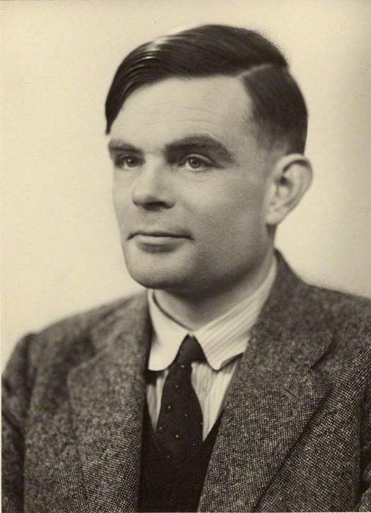
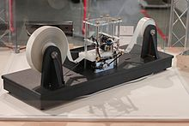
Turing
Universal Turing Machine – a machine that can calculate anything that is calculatable (in his seminal paper: „On Computable Numbers, with an Application to the Entscheidungsproblem”)
1950 - Turing test

Slide 4
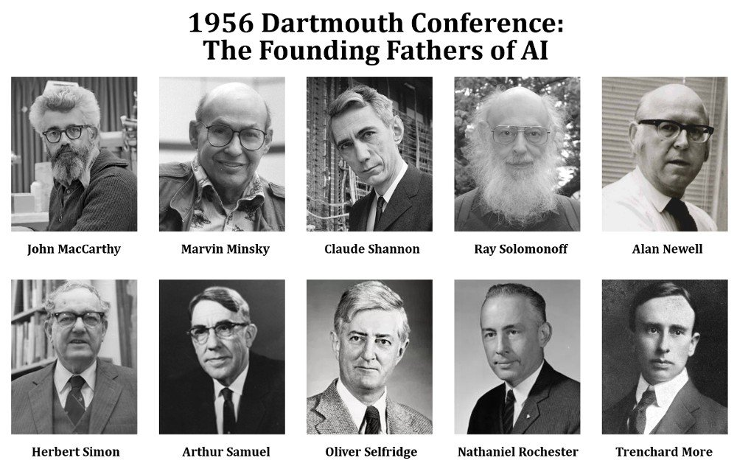
From the „start” to the Darthmouth Conference
1943 – McCulloch & Pitts – Artificial Neuron model
1949 – Donald Hebb – Hebbian Learning
1950 – Minsky & Edmonds – SNARC the first neural computer
1955 – John McCarthy, Darthmouth Summer Project on AI

Slide 5
First golden era, with high hopes
Logic Theorist
General Problem Solver – first „humanly” thinking program
1959 – Geometry Theorem Prover
1959 – MIT AI Lab set up
1962 – Rosenblatt’s Perceptron
Too much optimism about the performance in the first era

Slide 6
AI winter
Illusion of the infinite computational capacity
Lighthill report
"In no part of the field have the discoveries made so far produced the major impact that was then promised"
Governments started to reduce fundings on AI
Minsky & Papert: Perceptrons (XOR affair)

Slide 7
Expert systems
1969 - DENDRAL program for molecule structure analysis
1971 – MYCIN for blood disease diagnosys (450 rules)
1982 - R1 first commercially used AI for computer configurations
Schank and his students: multiple NLP programs
1981 – Japan’s fifth generation project
Microelectronics and Computer Technology Corporation (MCC)

Slide 8
NNs again & Probability in the inference & ML
1980s - At least 4 research groups reinvent the backpropagation algorithm
Connectionists
Models that can learn
Rigid expert systems → probability & hard coded → ML
Hidden Markov models
Bayes networks
Markov Decision Process

Slide 9
Deep Learning
Big Data
2007 - Hays & Efros – picture restoring algorithm
Much better with huge database
2009 – ImageNet – revolutionized the Computer Vision field
2012 – Hinton’s group achieves a much better solution on the ImageNet challenge
AI is achieving better equal or performance in some problems compared to humans

Slide 10
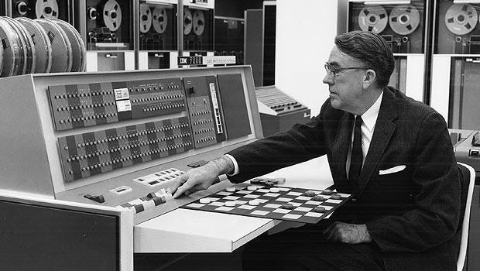

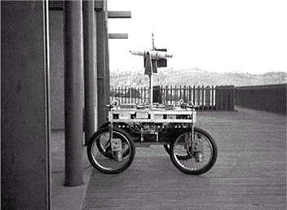
Some AI applications on a timeline
1951 – Checkers-playing program (first AI)
Christopher Strachey; Univ. Of Manchester
1964 – STUDENT (algebra word problems solver)
Daniel G. Bobrow
1956 – First self learning program
Arthur Samuel; IBM
1966 – ELIZA first „ChatBot”
Joseph Weizenbaum; MIT
1970s – Stanford Cart, first autonomous vehicle
Stanford AI Lab

Slide 11
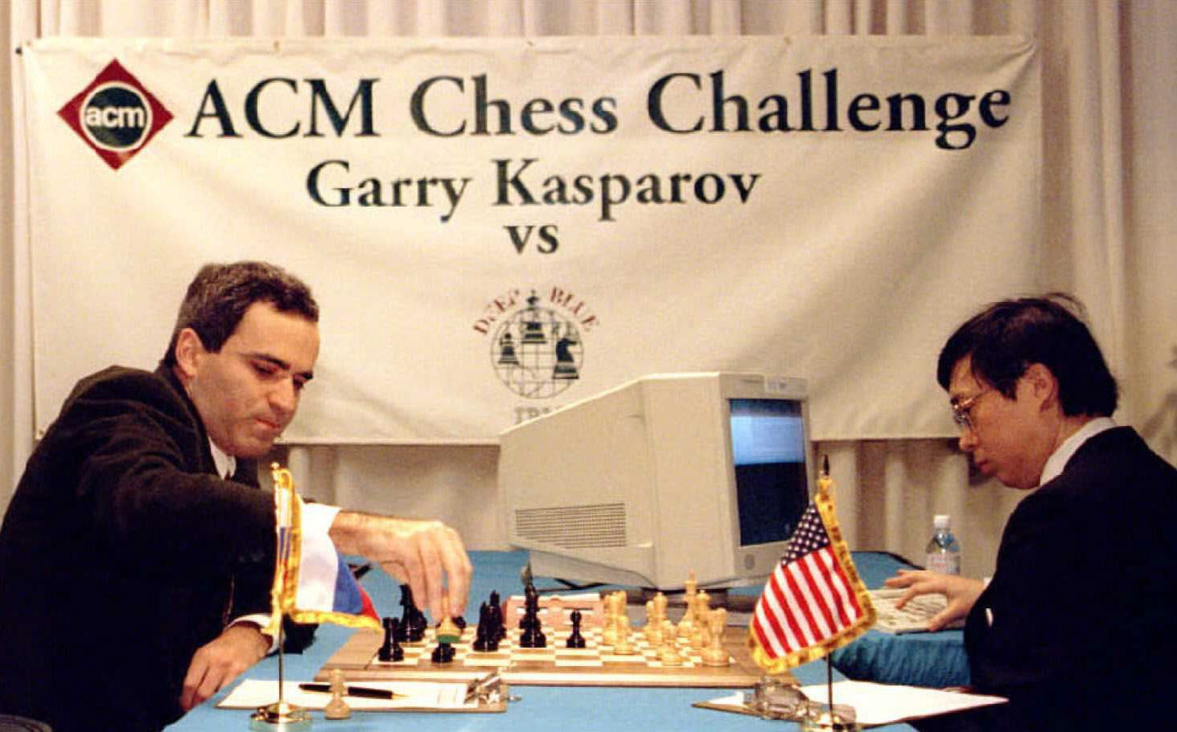
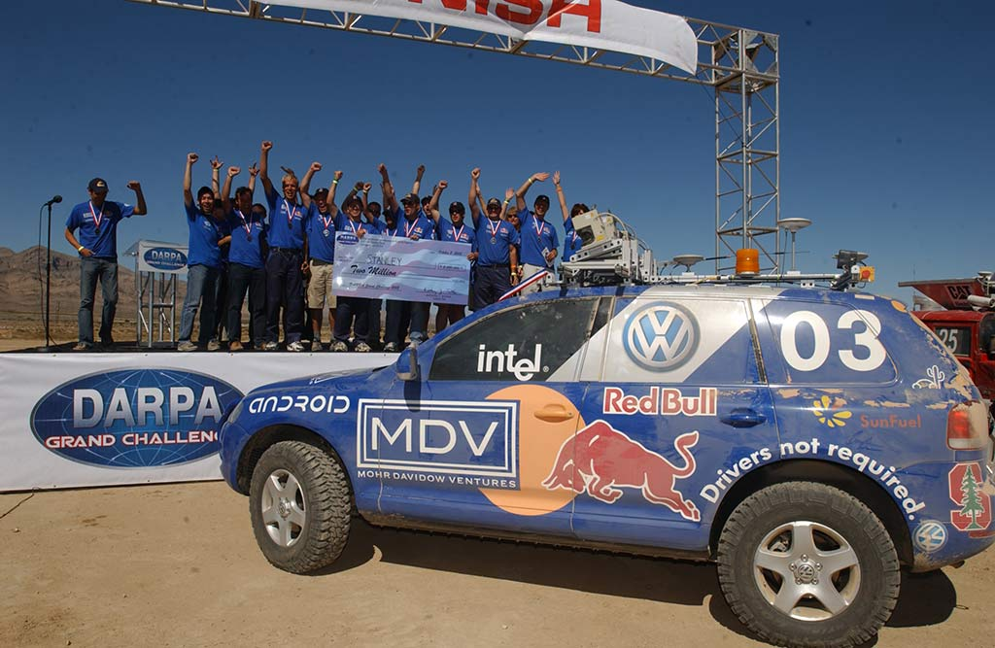
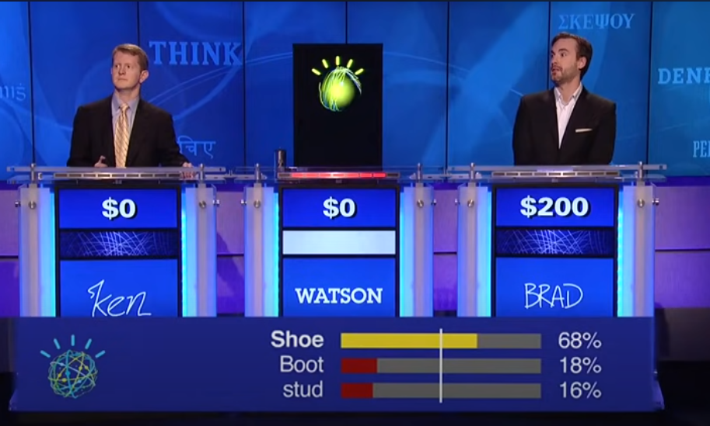
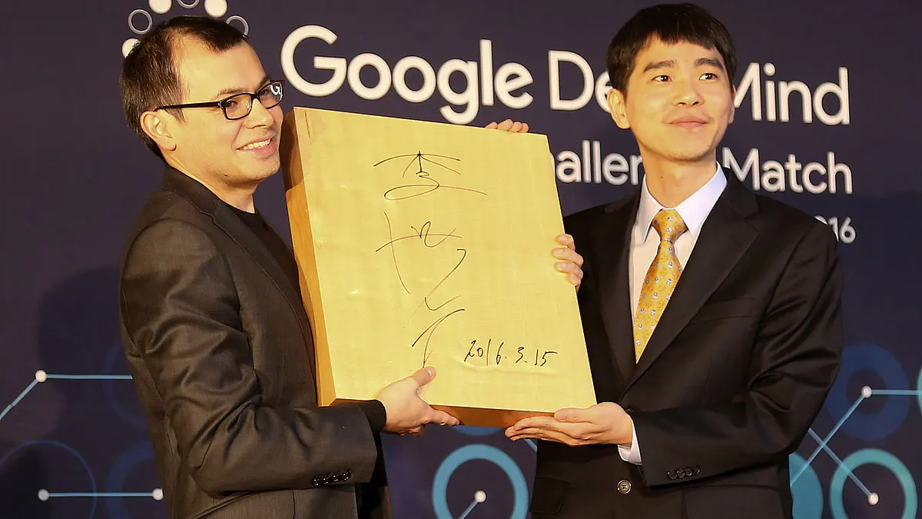
Some AI applications on a timeline (cont.)
1997 – AI beats Garry Kasparov in chess
Deep Blue
2004 – DARPA challenge
2011 – Watson wins Jeopardy challenge
IBM
2016 – AlphaGo beats Lee Sedol
Google DeepMind
2022 – ChatGPT
OpenAI

Slide 12
Search Systems

Slide 13
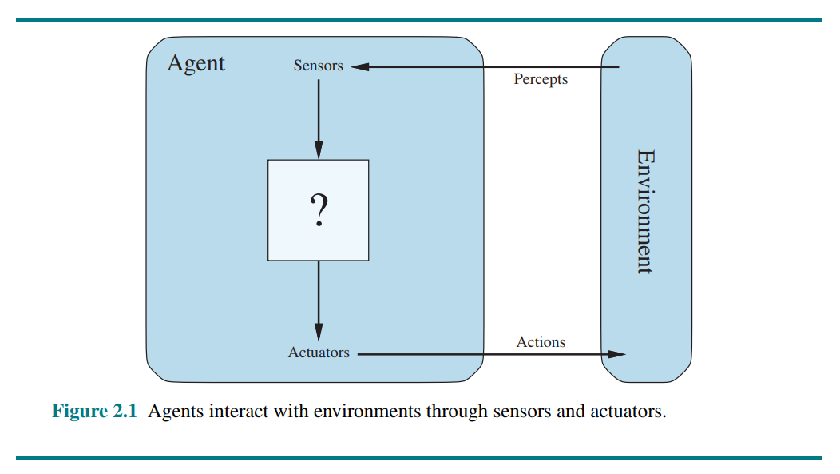
Search System
In a search system, we have an agent interacting with an environment through sensors and actuators
The agent takes actions within the environment in order to achieve a goal

Slide 14



Search System - Plan ahead
When the correct action to take is not immediately obvious, the agent may need to plan ahead
to consider a sequence of actions that form a path to a goal state.
The agent is called a problem-solving agent, and the computational process it undertakes is called search.

Slide 15

Search System - Agent
An agent is anything that can be viewed as perceiving its environment through sensors and acting upon that environment through actuators
We use the term percept to refer to the content an agent’s sensors are perceiving.

Slide 16
Search Systems – Rational agents
What is rational at any given time depends on four things:
The performance measure that defines the criterion of success.
The agent’s prior knowledge of the environment.
The actions that the agent can perform.
The agent’s percept sequence to date.
Rational Agent
an agent that, for each possible percept sequence, selects an action that is expected to maximize its performance measure, given the evidence provided by the percept sequence and whatever built-in knowledge the agent has.

Slide 17
The environment which the agent acts has the following properties:
Fully observable vs Partially observable
Single agent vs Multi agent
Deterministic vs Non-deterministic
Episodic vs Sequential
Static vs Dynamic
Discrete vs Continuous
Known vs Unknown

Slide 18
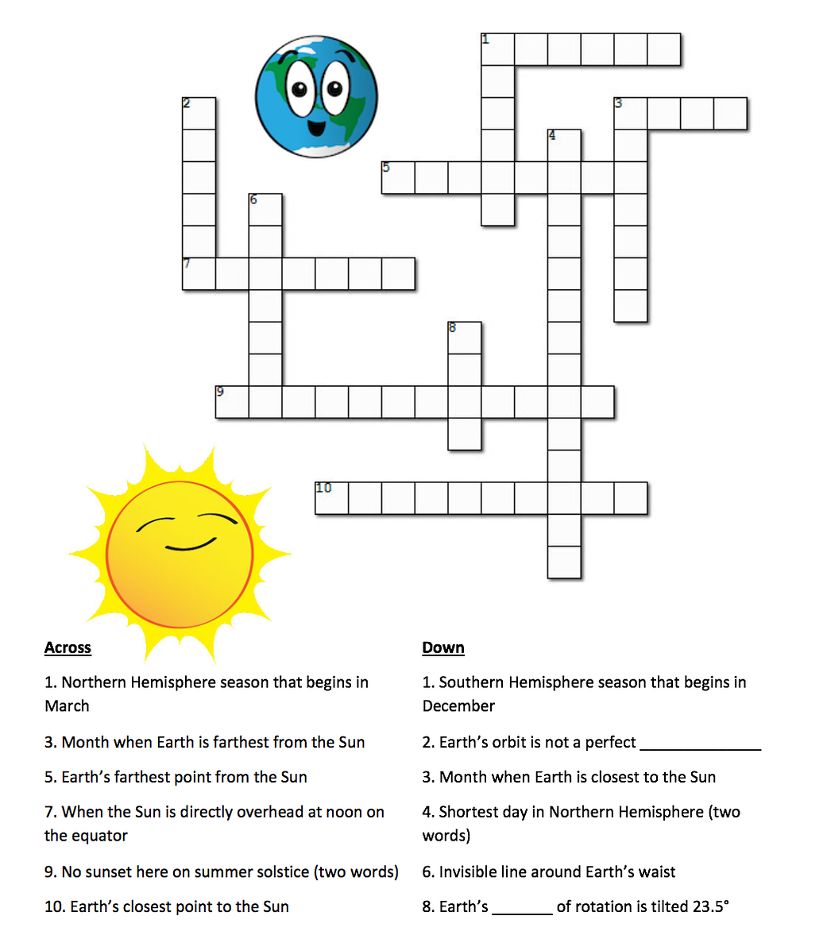
Environment - example
Task Environment | Observable | Agents | Deterministic | Episodic | Static | Discrete
Crossword puzzle | Fully | Single | Deterministic | Sequential | Static | Discrete
Taxi driving

Slide 19
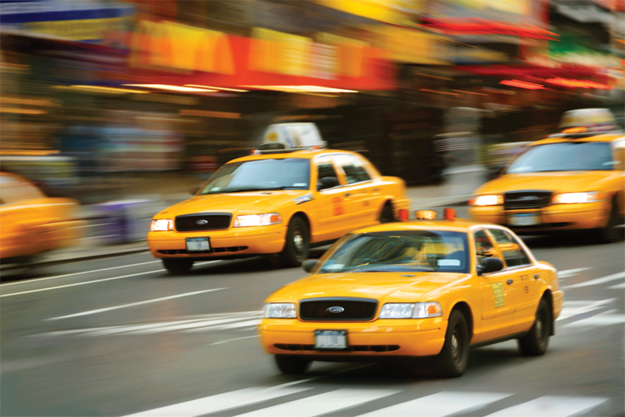
Environment - example
Task Environment | Observable | Agents | Deterministic | Episodic | Static | Discrete
Crossword puzzle | Fully | Single | Deterministic | Sequential | Static | Discrete
Taxi driving | Partially | Multi | Stochastic | Sequential | Dynamic | Continuous

Slide 20
Search System - Example
Imagine an agent enjoying a touring vacation in Romania. The agent wants to take in the sights, improve its Romanian, enjoy the nightlife, avoid hangovers, and so on.

Slide 21
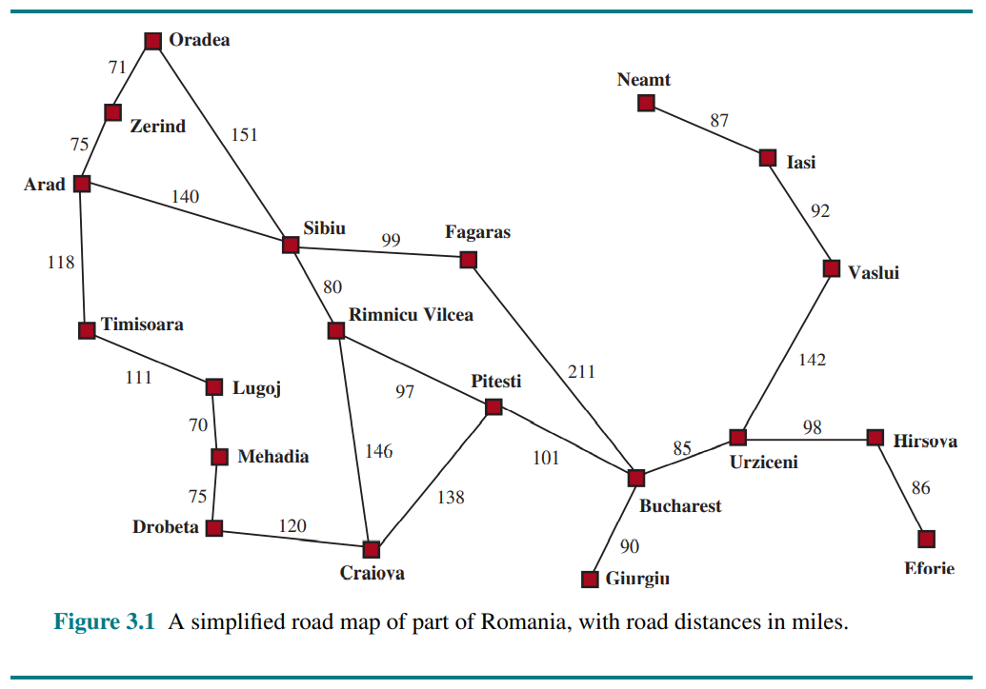
Search System - Example
Imagine an agent enjoying a touring vacation in Romania. The agent wants to take in the sights, improve its Romanian, enjoy the nightlife, avoid hangovers, and so on.
Suppose the agent is currently in the city of Arad
Agent is here

Slide 22
Search System – Example
Imagine an agent enjoying a touring vacation in Romania. The agent wants to take in the sights, improve its Romanian, enjoy the nightlife, avoid hangovers, and so on.
Suppose the agent is currently in the city of Arad
and has a non-refundable ticket to fly out of Bucharest the following day.
Agent is here
Agent should come here

Slide 23
Search System - Example
Imagine an agent enjoying a touring vacation in Romania. The agent wants to take in the sights, improve its Romanian, enjoy the nightlife, avoid hangovers, and so on.
Suppose the agent is currently in the city of Arad
and has a non-refundable ticket to fly out of Bucharest the following day.
The agent observes street signs and sees that there are three roads leading out of Arad: one toward Sibiu, one to Timisoara, and one to Zerind. None of these are the goal
Agent is here
Agent should come here

Slide 24
Search System - Example
Imagine an agent enjoying a touring vacation in Romania. The agent wants to take in the sights, improve its Romanian, enjoy the nightlife, avoid hangovers, and so on.
Suppose the agent is currently in the city of Arad
and has a non-refundable ticket to fly out of Bucharest the following day.
The agent observes street signs and sees that there are three roads leading out of Arad: one toward Sibiu, one to Timisoara, and one to Zerind. None of these are the goal
The agent has a map
Agent is here
Agent should come here

Slide 25
Search System - Example
With that information, the agent can follow a four-phase problem-solving process:
Goal formulation: The agent adopts the goal of reaching Bucharest. Goals organize behaviour by limiting the objectives and hence the actions to be considered.
Problem formulation: The agent devises a description of the states and actions necessary to reach the goal. For example, consider the actions of traveling from one city to an adjacent city
Agent is here
Agent should come here

Slide 26
Search System - Example
With that information, the agent can follow a four-phase problem-solving process:
Search: Before taking any, the agent simulates sequences of actions in its model, searching until it finds a sequence of actions that reaches the goal. (solution, e.g. Arad -> Sibiu -> Fagaras -> Bucharest )
Execution: The agent can now execute the actions in the solution, one at a time.
Agent is here
Agent should come here

Slide 27
Problem formulation
State space
Initial State
Goal state
Actions
Transition model
Action cost function

Slide 28
Search System - Notes
A sequence of actions forms a path, and a solution is a path from the initial state to a goal state.
Action costs are additive; that is, the total cost of a path is the sum of the individual action costs. An optimal solution has the lowest path cost among all solutions.
The state space can be represented as a graph in which the vertices are states and the directed edges between them are actions.

Slide 29
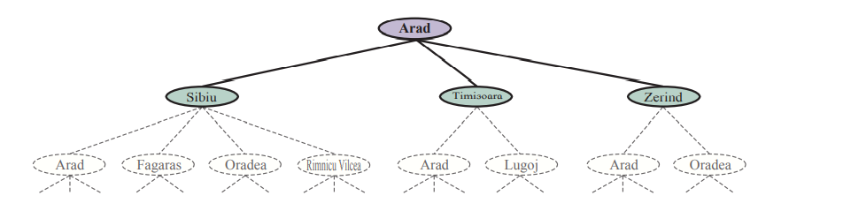
General scheme of a search system
A search algorithm takes a search problem as input and returns a solution, or an indication of failure.
We can consider a search algorithm as an algorithm that superimposes a search tree over the state-space graph, forming various paths from the initial state, trying to find a path that reaches a goal state.

Slide 30
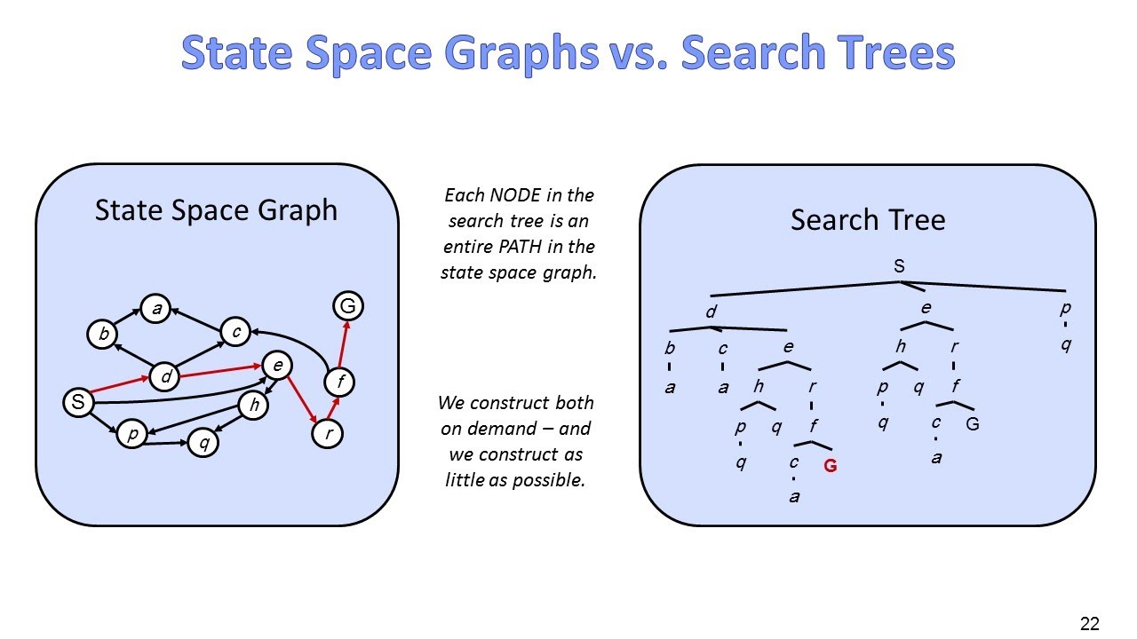
State Space vs Search Tree.
The state space describes the (possibly infinite) set of states in the world, and the actions that allow transitions from one state to another.
The search tree describes paths between these states, reaching towards the goal.

Slide 31
Nodes, edges, root
Each node in the search tree corresponds to a state in the state space
The edges in the search tree correspond to actions.
The root of the tree corresponds to the initial state of the problem

Slide 32
Search System - Process
We can expand the node, by considering the available ACTIONS for that state, using the RESULT function to see where those actions lead to, and generating a new node (called a child node or successor node) for each of the resulting states. Each child node has Arad as its parent node.

Slide 33
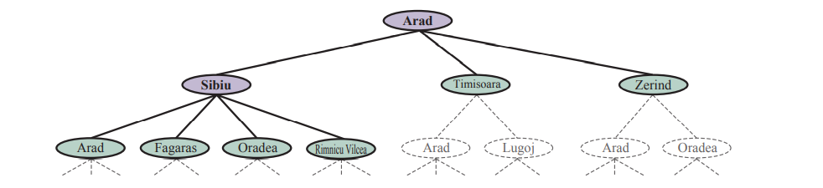
Search System – Process (cont.)
Choose which of these three child nodes to consider next (following up one option now and putting the others aside for later)
Choose to expand Sibiu first. It generates 4 new nodes, resulting in a set of 6 unexpanded nodes. We call this the frontier of the search tree. We say that any state that has had a node generated for it has been reached (whether or not that node has been expanded).

Slide 34
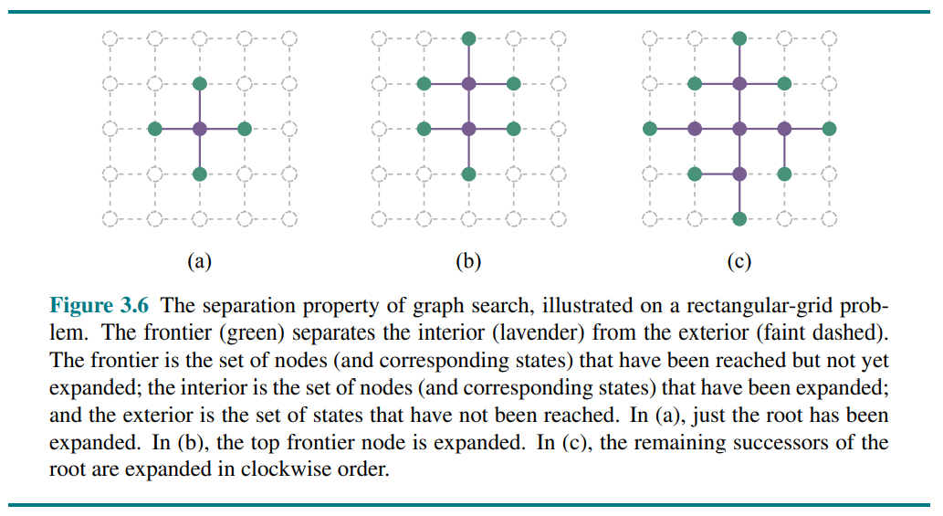
Search System
Frontier separates two regions of the state-space graph:
an interior region where every state has been expanded,
and an exterior region of states that have not yet been reached.

Slide 35
Control Strategies
How do we decide which node from the frontier to expand next?

Slide 36
There is a very general approach called Best-First Search
We choose a node n with minimum value of some evaluation function f(n)
On each iteration we choose a node on the frontier with minimum f(n) value
return it if its state is a goal state,
otherwise apply EXPAND to generate child nodes.
Each child node is added to the frontier if it has not been reached before or is re-added if it is now being reached with a path that has a lower path cost than any previous path.
The algorithm returns either an indication of failure, or a node that represents a path to a goal.
By employing different f(n) functions, we get different specific algorithms.

Slide 37
Measuring problem-solving performance
We need a criteria used to choose among different algorithms. We can evaluate an algorithm’s performance in four ways:
Completeness: Is the algorithm guaranteed to find a solution when there is one, and to correctly report failure when there is not?
Cost optimality: Does it find a solution with the lowest path cost of all solutions?
Time complexity: How long does it take to find a solution? This can be measured in seconds, or more abstractly by the number of states and actions considered.
Space complexity: How much memory is needed to perform the search?

Slide 38
Control Strategies
Control Strategy tells us about which rule has to be applied next while searching for the solution of a problem within problem space.
It helps us decide when there are more than 1 matching rules
A good control strategy should:
Cause motion
Be systematic

Slide 39
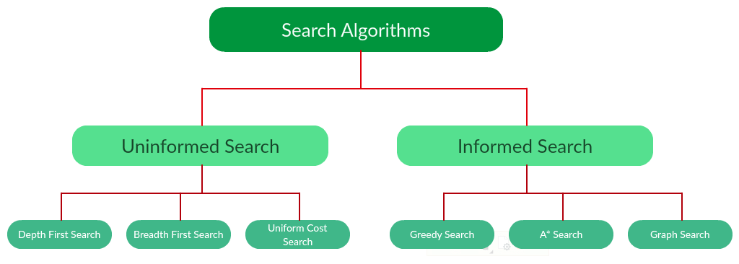
Control Strategies
We distinguish between informed algorithms, in which the agent can estimate how far it is from the goal, and uninformed algorithms, where no such estimate is available.

Slide 40
Each of these algorithms will have:
A problem graph, containing the start node S and the goal node G.
A strategy, describing the manner in which the graph will be traversed to get to G.
A data structure used to store all the possible states (nodes) that you can go from the current states.
A tree, that results while traversing to the goal node.
A solution plan, which is the sequence of nodes from S to G.

Slide 41
Uninformed search (blind search)
Also called blind, exhaustive or brute-force search
Does not have additional information about the states beyond problem definition
Total search space is looked for solution
No information is used to determine the preference of one child node over other
The plans to reach the goal state from the start state differ only by the order and/or length of actions.
Example algorithms: Breadth First Search (BFS), Depth First Search (DFS), Uniform Cost Search (UCS)

Slide 42
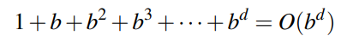
Breadth-First Search (BFS)
Desirable when all actions have the same cost
Steps: root node is expanded first, then all the successors of the root node are expanded next, then their successors, and so on.
BFS always finds a solution with a minimal number of actions, because when it is generating nodes at depth d, it has already generated all the nodes at depth d −1, so if one of them were a solution, it would have been found.
However, if the solution is at the depth d, then the total number of nodes generated is
where b is the number of child nodes of a node
Thus, this algorithm has exponential complexity.

Slide 43
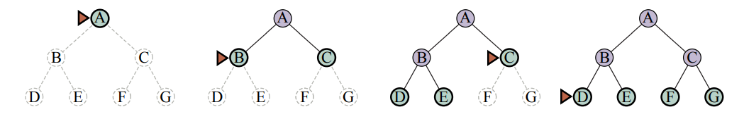
Breadth-First Search (BFS)

Slide 44
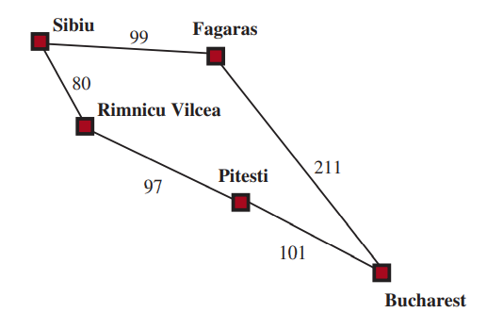
Uninformed-Cost Search (UCS) / Dijkstra’s algorithm
Desirable when actions have different costs
Evaluation function is the cost of the path from the root to the current node.
Example problem:
to get from Sibiu to Bucharest.

Slide 45
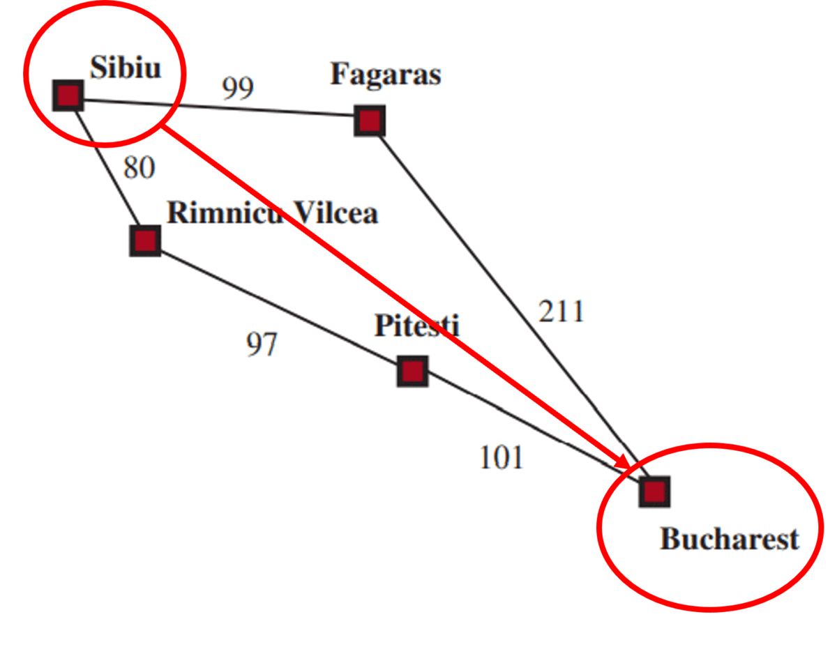
Uninformed-Cost Search (UCS)
The problem is to get from Sibiu to Bucharest.
The successors of Sibiu are Rimnicu Vilcea and Fagaras, with costs 80 and 99, respectively.
The least cost node, Rimnicu Vilcea, is expanded next
Only Pitesti, adding Pitesti with cost 80 + 97=177.
The least-cost node is now Fagaras, so it is expanded,
adding Bucharest with cost 99+211=310.
Bucharest is the goal, but the algorithm tests for goals only when it expands a node, not when it generates a node, so it has not yet detected that this is a path to the goal.
The algorithm continues on, choosing Pitesti for expansion next and adding a second path to Bucharest with cost 80 + 97 + 101=278.
278 has a lower cost, so it is chosen as next to continue. Therefore, we expand Bucharest
Bucharest is the goal, so the algorithm returns it

Slide 46
Depth-first search (DFS)
Always expands the deepest node in the frontier first.
It is usually implemented not as a graph search but as a tree-like search that does not keep a table of reached states.
Depth-first search is not cost-optimal; it returns the first solution it finds, even if it is not cheapest.
Desirable only for problems where a tree-like search is feasible
DFS has much smaller needs for memory

Slide 47
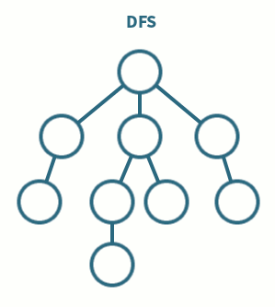
Depth-first search (DFS)

Slide 48
Extras
Beam search,
Depth-limited,
Iterative deepening,
Bidirectional,
Recursion,
Different weighting,
Some random choice,
…

Slide 49
Informed search (heuristic search)
Also called heuristic or intelligent search, uses information about the problem to guide the search. Usually has an estimate of the distance to a goal state, and is therefore efficient, but the search may not be always possible.
Information about the problem space (heuristic) is used to compute preference among the children for exploration and expansion. Usually, more efficient than uninformed strategies
Heuristic function H maps each state to a numerical value which depicts goodness of a node n
H(n) = estimated cost of the cheapest path from the state at node n to a goal state
Examples: Greedy Best-first search, A*, etc.

Slide 50
Informed Search Strategies
A heuristic is a task-related idea that is directly used in an algorithm in order to improve its effectiveness and efficiency
(it can improve both running time and memory requirements), although this is usually not guaranteed.
Cost
Total cost
Cost of choosing the next step
Number of required step
Information

Slide 51
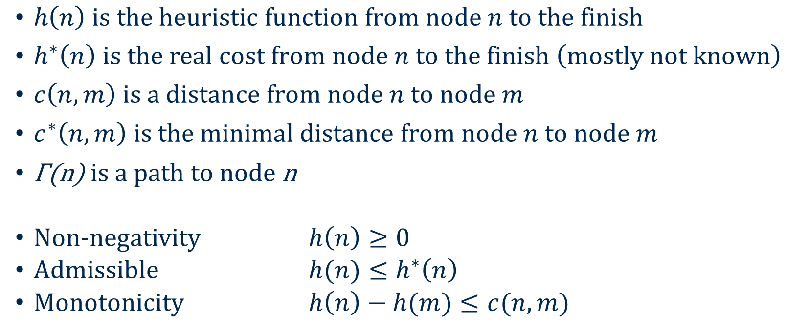
Heuristic function definitions and properties
$h\left(n\right) is the heuristic function from node n to the finish$
$h^{∗}\left(n\right) is the real cost from node n to the finish \left(mostly not known\right)$
$c\left(n,m\right) is a distance from node n to node m$
$c^{∗}\left(n,m\right) is the minimal distance from node n to node m$
$\text{Γ}\text{(}\text{n}\text{) }\text{is} \text{a} \text{path} \text{to} \text{node} \text{n}$
Non-negativity $h\left(n\right)≥0$
Admissible $h(n)≤h^{∗}\left(n\right)$
Monotonicity $h\left(n\right)−h(m)≤c(n,m)$

Slide 52
Greedy Best-first search
A form of best-first search that expands first the node with the lowest h(n) value—the node that appears to be closest to the goal—on the grounds that this is likely to lead to a solution quickly.

Slide 53
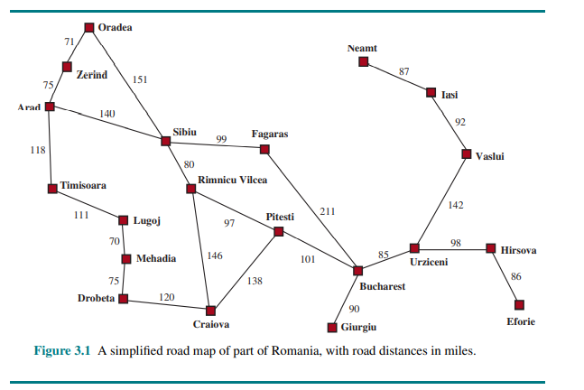
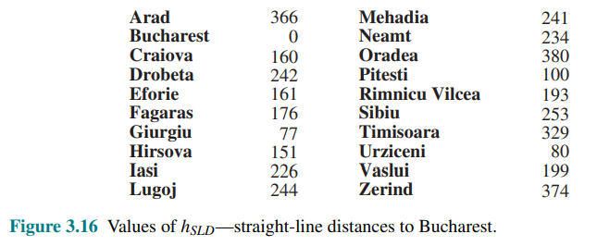
A* search
The evaluation function is
f(n) = g(n) + h(n)
f(n) = estimated cost of the best path that continues from n to a goal.
g(n) is the path cost from the initial state to node n,
and h(n) is the estimated cost of the shortest path from n to a goal state

Slide 54
Example: A* Search Algorithm
start state
n | h(n)
A | 40
B | 32
C | 25
D | 35
E | 19
F | 17
H | 10
G | 0
Open:[]
A
7
11
D
Closed:[]
14
C
25
B
10
F
8
15
E
20
G
goal state
9
H
10

Slide 55
Example: A* Search Algorithm
start state
n | h(n)
A | 40
B | 32
C | 25
D | 35
E | 19
F | 17
H | 10
G | 0
Open:[A]
A
A
7
11
D
Closed:[]
40=0+40
14
C
25
B
10
F
8
15
E
20
G
goal state
9
H
10

Slide 56
Example: A* Search Algorithm
start state
n | h(n)
A | 40
B | 32
C | 25
D | 35
E | 19
F | 17
H | 10
G | 0
Open:[]
A
A
7
11
D
Closed:[A]
14
[B,C,D]
B
D
25
C
C
43=11+32
42=7+35
B
10
39=14+25
F
8
15
E
20
G
goal state
9
H
10

Slide 57
Example: A* Search Algorithm
start state
n | h(n)
A | 40
B | 32
C | 25
D | 35
E | 19
F | 17
H | 10
G | 0
Open:[C,D,B]
A
A
7
11
D
Closed:[A]
14
B
D
25
C
C
43=11+32
42=7+35
B
10
39=14+25
F
8
15
E
20
G
goal state
9
H
10

Slide 58
Example: A* Search Algorithm
start state
n | h(n)
A | 40
B | 32
C | 25
D | 35
E | 19
F | 17
H | 10
G | 0
Open:[D,B]
A
A
7
11
D
Closed:[A,C]
14
B
D
[E,F,A]
25
C
C
43=11+32
42=7+35
B
10
39=14+25
F
8
15
E
20
G
goal state
9
H
10

Slide 59
Example: A* Search Algorithm
start state
n | h(n)
A | 40
B | 32
C | 25
D | 35
E | 19
F | 17
H | 10
G | 0
Open:[D,B]
A
A
7
11
D
Closed:[A,C]
14
B
D
[E,F,A]
25
C
C
43=11+32
42=7+35
B
10
F
E
8
F
15
20
41=14+8+19
41=14+10+17
E
G
goal state
9
H
10

Slide 60
Example: A* Search Algorithm
start state
n | h(n)
A | 40
B | 32
C | 25
D | 35
E | 19
F | 17
H | 10
G | 0
Open:[F,E,D,B]
A
A
7
11
D
Closed:[A,C]
14
B
D
25
C
C
43=11+32
42=7+35
B
10
F
E
8
F
15
20
41=14+8+19
41=14+10+17
E
G
goal state
9
H
10

Slide 61
Example: A* Search Algorithm
start state
n | h(n)
A | 40
B | 32
C | 25
D | 35
E | 19
F | 17
H | 10
G | 0
Open:[E,D,B]
A
A
7
11
D
Closed:[A,C,F]
14
B
D
25
C
C
43=11+32
42=7+35
B
10
[G,D]
F
E
8
F
15
20
41=14+8+19
E
G
goal state
G
9
H
61=14+10+17+20+0
10

Slide 62
Example: A* Search Algorithm
start state
n | h(n)
A | 40
B | 32
C | 25
D | 35
E | 19
F | 17
H | 10
G | 0
Open:[E,D,B]
A
A
7
11
D
Closed:[A,C,F]
14
B
D
25
C
C
43=11+32
42=7+35
B
10
F
E
8
F
15
20
41=14+8+19
E
G
goal state
G
9
H
61=14+10+17+20+0
10
Path A->C->F->G

Slide 63
Example: A* Search Algorithm
start state
n | h(n)
A | 40
B | 32
C | 25
D | 35
E | 19
F | 17
H | 10
G | 0
Open:[D,B]
A
A
7
11
D
Closed:[A,C,F,E]
14
B
D
25
C
C
43=11+32
42=7+35
B
10
[H,B]
F
E
8
F
15
E
20
H
G
goal state
G
9
41=14+8+9+10
H
61=14+10+17+20+0
10

Slide 64
Example: A* Search Algorithm
start state
n | h(n)
A | 40
B | 32
C | 25
D | 35
E | 19
F | 17
H | 10
G | 0
Open:[H,D,B]
A
A
7
11
D
Closed:[A,C,F,E]
14
B
D
25
C
C
43=11+32
42=7+35
B
10
F
E
8
F
15
E
20
H
G
goal state
G
9
G
61=14+10+17+20+0
H
10
41=14+8+9+10

Slide 65
Example: A* Search Algorithm
start state
n | h(n)
A | 40
B | 32
C | 25
D | 35
E | 19
F | 17
H | 10
G | 0
Open:[D,B]
A
A
7
11
D
Closed:[A,C,F,E,H]
14
B
D
25
C
C
43=11+32
42=7+35
B
10
[G,E]
F
E
8
F
15
E
20
H
G
goal state
G
9
G
61=14+10+17+20+0
H
10
Path: A->C->E->H->G
41=14+8+9+10

Slide 66
Example: A* Search Algorithm
start state
n | h(n)
A | 40
B | 32
C | 25
D | 35
E | 19
F | 17
H | 10
G | 0
Open:[D,B]
A
A
7
11
D
Closed:[A,C,F,E,H]
14
B
D
25
C
C
43=11+32
42=7+35
B
10
F
E
8
F
15
Optimal Solution
E
20
H
G
goal state
G
9
G
61=14+10+17+20+0
H
10
Path: A->C->E->H->G
41=14+8+9+10
Path A->C->F->G

Slide 67
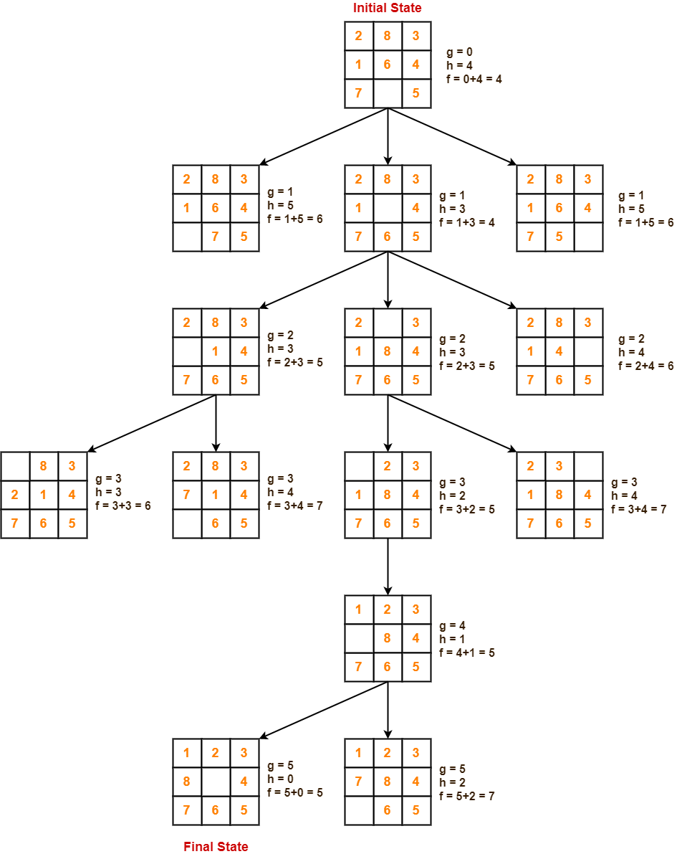
Example : A* Search Algorithm
A* search is complete
- The state space is either has a solution or is finite
A* search ensures the optimal solution
A* search provided that h(n) is admissible
- Never overestimates to reach a goal

Slide 68
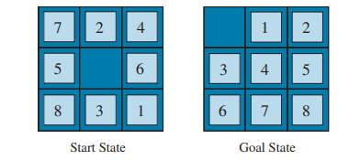
Heuristic function - example
How to create heuristic functions
Example: 8-puzzle.
The objective of the puzzle is to slide the tiles horizontally or vertically into the empty space until the configuration matches the goal configuration.

Slide 69
Heuristic function - example
h1 = the number of misplaced tiles (blank not included)
All eight tiles are out of position, so the start state has h1 = 8.
h1 is an admissible heuristic because any tile that is out of place will require at least one move to get it to the right place.

Slide 70
Heuristic function - example
h2 = the sum of the distances of the tiles from their goal positions.
Because tiles cannot move along diagonals, the distance is the sum of the horizontal and vertical distances— sometimes called the city-block distance or Manhattan distance.
h2 is also admissible because all any move can do is move one tile one step closer to the goal.

Slide 71
Heuristic function - example
Tiles 1 to 8 in the start state give a Manhattan distance of
h2 = 3+1+2+2+2+3+3+2 = 18.
As expected, neither of these overestimates the true solution cost, which is 26

Slide 72
Local search and optimization problems
Local search algorithms operate by searching from a start state to neighboring states, without keeping track of the paths, nor the set of states that have been reached. That means they are not systematic they might never explore a portion of the search space where a solution resides.
They use very little memory.
They can often find reasonable solutions in large or infinite state spaces for which systematic algorithms are unsuitable.
Can also solve optimization problems, in which the aim is to find the best state according to an objective function.

Slide 73
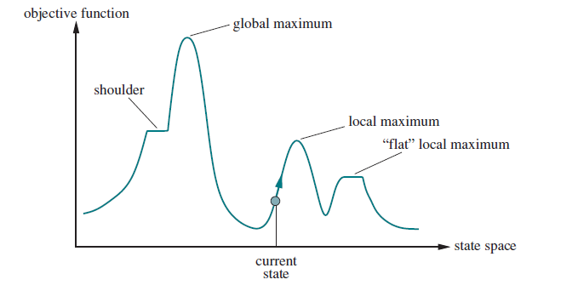
Local search and optimization problems
State space landscape with elevation, if we consider elevation being an objective function then the process of finding the global maximum would be called hill-climbing in the other hand if we consider the elevation a cost function then the process of finding a global minimum would be gradient descent

Slide 74
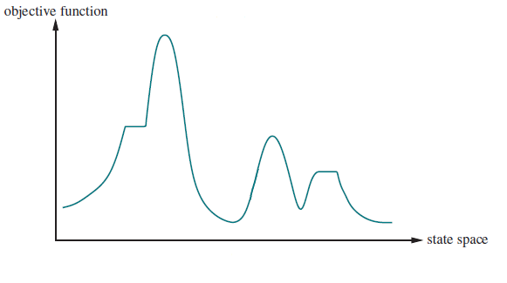
Problem definition
The objective function can show some kind of positive value that needs to be maximized (e.g. profit, population, number of waypoints reached, number of people saved).
Alternatively, it can be a cost function that needs to be minimized (e.g. memory usage, CPU usage, energy consumption, financial cost).

Slide 75
Problem definition
Simplest way of finding a solution: exhaustive search.
On a one-dimensional problem space this looks doable, yet even there we can run into problems.
Can be costly / impossible

Slide 76
Problem definition
Simple heuristic using local characteristics (gradient):
Hill Climbing for maximization problems
Gradient Descent for minimization problems

Slide 77
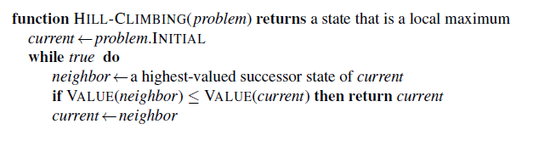
Hill-climbing search
On each iteration it moves the current state to the neighboring state with highest value.
It heads in the direction that provides the steepest ascent.
It terminates when it reaches a peak where no neighbor has a higher value.

Slide 78
Types of hill-climbing algorithm
Simple Hill-Climbing: It examines the neighboring nodes one by one and selects the first neighboring node which optimizes the current cost as the next node.
If initial state is a goal state, then stop and return success otherwise current state = initial state.
Loop until solution is found or no new state:
If the current state is a goal state, then stop and return success
Select a new state.
If the new state is better than the current state, then make the new state the current state.

Slide 79
Types of hill-climbing algorithm
Steepest-Ascent Hill-Climbing:
This variation examines all the neighboring nodes of the current state and selects one neighbor node which is closest to the goal state, it consumes more time as it searches for multiple neighbors.
If initial state is a goal state, then stop and return success otherwise current state = initial state.
Loop until solution is found or no new state:
Select a new state
Initialize a best state = current state
If current state is goal state, then stop and return success
If new state is better than the best state, then make the best state = new state
Make the best state as the current state

Slide 80
Types of hill-climbing algorithm
Stochastic Hill-Climbing:
It does not examine all the neighboring nodes before deciding which node to select. It just selects a neighboring node at random and decides whether to move to that neighbor or to examine another.
If initial state is a goal state, then stop and return success otherwise current state = initial state.
Loop until solution is found or no new state:
Generate all neighboring states
Among the generated neighbor states which are better than the current state choose a state randomly.
If the chosen state is the goal state, then return success, else make it the current state.

Slide 81
Types of hill-climbing algorithm
Other variants of the stochastic Hill-Climbing:
First-choice hill climbing generates successors randomly until one is generated that is better than the current state.
Random-restart hill climbing adopts the adage, “If at first you don’t succeed, try, try again”. It conducts a series of hill-climbing searches from randomly generated initial states, until a goal is found.

Slide 82
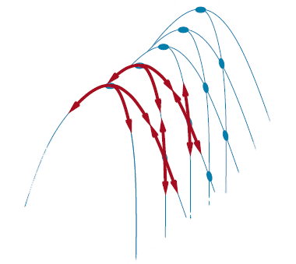
Problems with hill-climbing
Local maximum:
At this point, the neighboring states have lower values than the current state. The greedy feature will not move the algorithm to a worse state and the process will terminate. One way to overcome is to use backtracking techniques maintaining a list of valid states.
Plateau:
In this region, the values attained by the neighboring states are the same, to avoid such dead-end big jumps can be used or limited sideways moves to not wander on the plateau for ever.
Ridge:
The algorithm may terminate itself when it reaches a ridge. Moving in several directions at once

Slide 83
Hill Climbing
Hill Climbing Search keeps track of only the current state, and searches its neighborhood for the highest value.
It is heading in the direction of the steepest ascent
Gradient Descent is the opposite

Slide 84
Hill Climbing
Hill Climbing Search keeps track of only the current state, and searches its neighbourhood for the highest value.
It is heading in the direction of the steepest ascent
Gradient Descent is the opposite
For discrete problems the question of the neighborhood might be trivial. For continuous problems, not necessarily, and a „step size” needs to be defined
What is the right step size?
Issues with too small step: slow convergence
Issues of too big step: possibly jumping over solutions

Slide 85
Hill Climbing
Will Hill Climbing find the maximum on this state space?

Slide 86
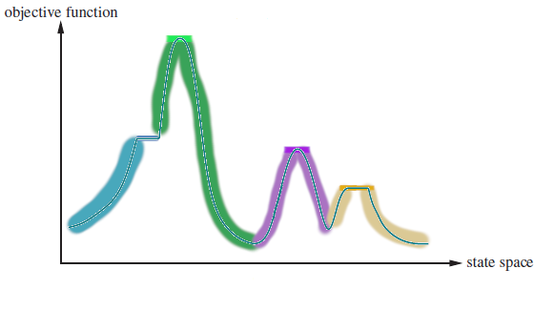
Hill Climbing
Depending on the starting position, different maxima will be found and converged to.

Slide 87
Hill Climbing
Hill Climbing is a greedy local search, it does not look ahead, just picks the immediately most beneficial next position.

Slide 88
Hill Climbing
Good: can be rather quick
Bad:
it can get stuck in sub-optimal solutions like local maxima, ridges or plateaus.

Slide 89
Hill Climbing
Good: can be rather quick
Bad:
it can get stuck in sub-optimal solutions like local maxima, ridges or plateaus.
The found solution is starting point dependent

Slide 90
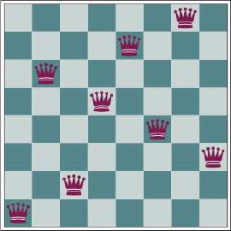
Descending the 8 queens
The 8-queens problem: Place 8 queens without any of them attacking each other

Slide 91
Descending the 8 queens
The 8-queens problem: Place 8 queens without any of them attacking each other
Heuristic function: the # of pairs of queens attacking each other; in this image, 1. For a solution, 0

Slide 92
Descending the 8 queens
The 8-queens problem: Place 8 queens without any of them attacking each other
Heuristic function: the # of pairs of queens attacking each other; in this image, 1
Successor states: moving a single queen to another square in the same column

Slide 93
Descending the 8 queens
The 8-queens problem
Heuristic function
Successor states: moving a single queen to another square in the same column
You could allow any two queens to swap rows as well, for example

Slide 94
Descending the 8 queens
The 8-queens problem
Heuristic function
Successor states: moving a single queen to another square in the same column
In this setup there are no more valid moves, we got stuck in a sub-optimal situation

Slide 95
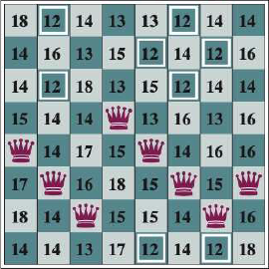
Descending the 8 queens
In this state, for example, each cell has its heuristic function value marked.
In this gradient descent problem the lowest possible next step has a value of 12.

Slide 96
Hill Climbing variants:
Sideways move
Stochastic
First-choice
Random Restart

Slide 97
Hill Climbing summary
Advantages
Easy to implement
Quickly converges
Always terminates
Disadvantages
Easily gets stuck
Starting point dependent

Slide 98
Tabu search
An improvement over the Hill Climb algorithm
Keeps a list of tabu states or tabu moves, in what is called a Tabu list.

Slide 99
Tabu search
An improvement over the Hill Climb algorithm
Keeps a list of tabu states or tabu moves, in what is called a Tabu list.
The Hill Climb algorithm checks the tabu list when it generates successor states to eliminate violating the tabu.

Slide 100
Tabu search example
Initial state: purple

Slide 101
Tabu search example
Initial state: purple
Hill Climb successor state: orange

Slide 102
Tabu search example
Initial state: purple
Hill Climb successor state: orange
Tabu states: gray

Slide 103
Tabu search example
Initial state: purple
Hill Climb successor state: orange
Tabu states: gray

Slide 104
Tabu search example
Initial state: purple
Hill Climb successor state: orange
Tabu states: gray

Slide 105
Tabu search example
Initial state: purple
Hill Climb successor state: orange
Tabu states: gray
...................

Slide 106
Tabu search example
Initial state: purple
Hill Climb successor state: orange
Tabu states: gray
...................

Slide 107
Tabu search details
Tabu are not permanent
In the Tabu List, whether the Tabu are states or moves, they also contain a duration
This is called Tabu Tenure, and it is kind of a Time-to-live figure: with each iteration all tenure is decreased by one.
Tabu with 0 tenure are removed from the list

Slide 108
Tabu search details
Initial state: purple
Hill Climb successor state: orange
Tabu states: gray
Tabu tenure: 15

Slide 109
Tabu search details
Tabu are not permanent
In the Tabu List, whether the Tabu are states or moves, they also contain a duration
This is called Tabu Tenure, and it is kind of a Time-to-live figure: with each iteration all tenure is decreased by one.
Tabu with 0 tenure are removed from the list
The higher the Tabu Tenure, the longer the memory of the algorithm
More agressively avoids stepping backwards
Uses more memory
Each iteration takes longer

Slide 110
Tabu search details
Tabu are not permanent: Tabu Tenure
Tabu are not absolute: Aspiration Criteria
Certain constraints can allow a move to violate a Tabu
For example, an otherwise tabu move is allowed, if
It allows a new global best solution, and
All allowed moves are worse than this one
The Tabu Tenure is then reset

Slide 111
Tabu search details
Tabu are not permanent: Tabu Tenure
Tabu are not absolute: Aspiration Criteria
Termination Condition:
Unlike Hill Climb, Tabu search will not naturally terminate
Example stopping conditions:
A fixed number of iterations
A number of iterations without improvement
A number of iterations without improvement of the global result

Slide 112
Tabu search algorithm
function TABU-SEARCH(problem, tabuTenure) returns a solution
current ← problem.INITIAL
tabu ← {}
while true do
foreach potential among the possible neighbours of current do
if potential fits Aspiration Criteria then successor ← potential
if potential highest-valued non-Tabu then successor ← potential
foreach banned in tabu do
banned.tenure -=1
if banned.tenure = 0 then tabu.pop(banned)
tabu.append(current)
current ← successor
if TERMINATING_CONDITION then return current

Slide 113
Tabu search summary
Advantages
Can get out of certain local extreme values
Less dependent on starting condition than Hill Climbing
Can really improve searches on graphs
Disadvantages
Longer run time than Hill Climbing
Termination condition unclear

Slide 114
Simulated Annealing
A version of stochastic Hill Climbing
Combines the greediness of Hill Climbing
With the exploration of a random walk

Slide 115
Simulated Annealing
A version of stochastic Hill Climbing
Combines the greediness of Hill Climbing
With the exploration of a random walk
Simulates a cooling-down effect
Initially the algorithm focuses on exploration: it operates on „high temperature” and is willing to accept „bad” moves
As time goes on, the algorithm „cools down” and it is more and more expecting successor states to improve the situation

Slide 116
Simulated Annealing
A version of stochastic Hill Climbing
Simulates a cooling-down effect
Compared to Hill Climbing:
When it generates successor states, it picks a random one, not the best one
If it is improving the situation, it is accepted (like in First-Choice Hill Climbing)

Slide 117
Simulated Annealing
A version of stochastic Hill Climbing
Simulates a cooling-down effect
Compared to Hill Climbing:
When it generates successor states, it picks a random one, not the best one
If it is improving the situation, it is accepted (like in First-Choice Hill Climbing)
If it is not improving the situation, it has a chance to be accepted based on its fitness ($∆E$) and the Temperature of the system: $p\left(E,T\right)=e^{\frac{∆E}{T}}$

Slide 118
Simulated Annealing
A version of stochastic Hill Climbing
Simulates a cooling-down effect
Compared to Hill Climbing:
When it generates successor states, it picks a random one, not the best one
If it is improving the situation, it is accepted (like in First-Choice Hill Climbing)
If it is not improving the situation, it has a chance to be accepted based on its fitness ($∆E$) and the Temperature of the system: $p\left(E,T\right)=e^{\frac{∆E}{T}}$
At the end of each iteration, the Temperature is adjusted according to a schedule

Slide 119
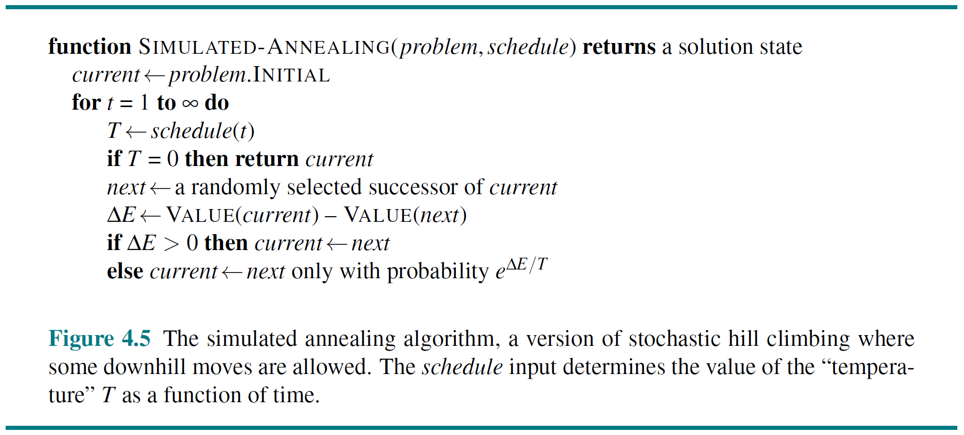
Simulated Annealing Algorithm

Slide 120
Simulated Annealing
The schedule along which T is adjusted is critical for the process. Different problems need different schedules
Exploration vs. Optimization times
Does not necessarily have to be monotonously decreasing
The Exit condition needs to be determined
E.g. T=0, for appropriate schedules
Other conditions can also be used, like those in Tabu search

Slide 121
Simulated Annealing
The combination of hill-climbing and random walk in a way that yields both efficiency and completeness.
Annealing is the process used to temper or harden metals and glass by heating them to a high temperature and then gradually cooling them, thus allowing the material to reach a low-energy crystalline state

Slide 122
Simulated Annealing
Changing from objective function to cost function and we have gradient descent.
If the current state was a ball, letting it rolling would be stuck in a local minimum. The trick is to shake just hard enough to bounce the ball out of the local minima but not hard enough to dislodge it from the global minimum.
Start shaking hard at a high temperature and then gradually reduce the intensity of the shaking lower the temperature.

Slide 123
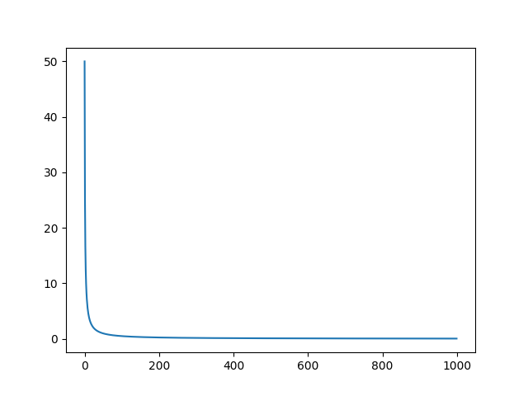
Annealing schedule
A worse state can be accepted probabilistically where the likelihood of accepting such a state is a function of the temperature of the search.
The temperature T is a function of t starting with initial temperature (hot) than cooled down over time.

Slide 124
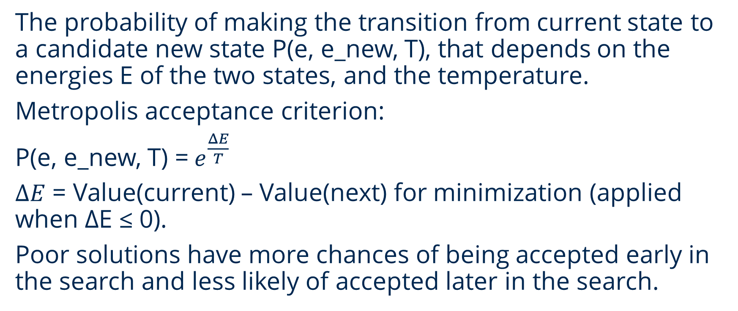
Acceptance probabilities
The probability of making the transition from current state to a candidate new state P(e, e_new, T), that depends on the energies E of the two states, and the temperature.
Metropolis acceptance criterion:
P(e, e_new, T) =${ e}^{\frac{ΔE}{T}}$
$ΔE$ = Value(current) – Value(next) for minimization (applied when ΔE ≤ 0).
Poor solutions have more chances of being accepted early in the search and less likely of accepted later in the search.

Slide 125

Simulated Annealing

Slide 126
Logic and inference

Slide 127
What is inference?
Mechanism that enables to produce an answer from a question, based on a model (which is in our case based on some learning on data).
Question
Learning
Inference
Data
Model
Answer

Slide 128
Logic in the AI research
Was a hot topic before 1990s (like currently Deep Learning)
Problems:
Deterministic (cannot handle uncertainity)
Can’t learn (no fine tuning of the model based on data)
Strength:
Expressiveness in a compact way

Slide 129
Building blocks of Propositional (and other) Logic
Syntax → how to make valid formulas
Semantics → what kind of meaning the formulas have
Inference Rules → operations on formulas
Syntax
Semantics
formula
Inference rules

Slide 130
Elements of Syntax
Prosodical Symbols: A, B, C
Logical connectives: $¬, ∧, ∨, →, ↔$
Recursive buildup of formulas:
If A and B are formulas then the following are formulas as well:
Negation: $¬A$
Conjunction: $A∧B$
Disjunction: $A∨B$
Implication: $A→B$
Bicondition: $A↔B$

Slide 131
Elements of Semantics
Model: assignment of truth values to propositional symbols
Interpretation function:
Let f be a formula
Let w be a model
The $I(f,w)$ returns:
True (1) if w satisfies f
False (0) if w does not satisfies f

Slide 132
Example – Interpretation function
Formula: $f=\left(¬A∧B\right)↔C$
Model: $w=\left\{A:1, B:1, C:0\right\}$
Interpretation:
$$I\left(\left(¬A∧B\right)↔C,w\right)=1$$
$$I\left(¬A∧B,w\right)=0$$
$$I\left(C,w\right)=0$$
$$I\left(¬A,w\right)=0$$
$$I\left(B,w\right)=1$$
$$I\left(A,w\right)=1$$

Slide 133
Formula represents a set of models
Let $M(f)$ be the set of models w for which $I\left(f,w\right)=1$.
Example: $f=Rain∨Wet$
Key idea: a formula compactly represents a set of models
Wet
0 1
$M(f)$ =
Rain
1 0

Slide 134
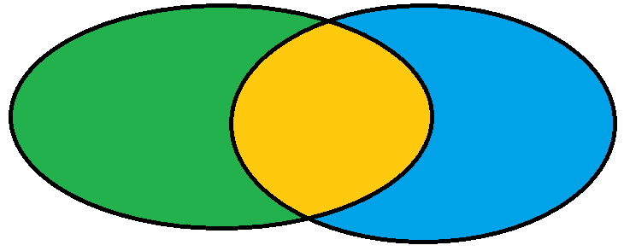
Knowledge base
A knowledge base (KB) is a set of formulas representing their conjunction / intersection:
$$M\left(KB\right)= \bigcap_{f∈KB}{M(f)}$$
Intuition: KB specifies the constraints on the world. $M\left(KB\right)$ is the set of all worlds satisfying those constraints
Example: Let $KB=\left\{Rain∨Snow, Traffic\right\}$
$$M(Rain∨Snow)$$
$$M(KB)$$
$$M(Traffic)$$

Slide 135
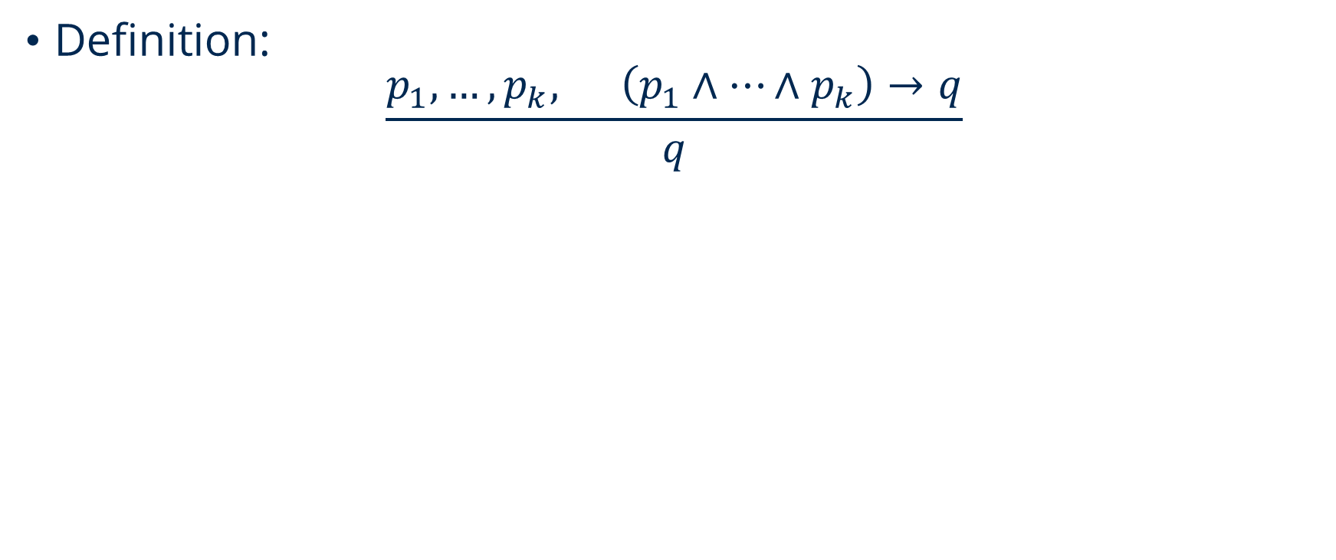
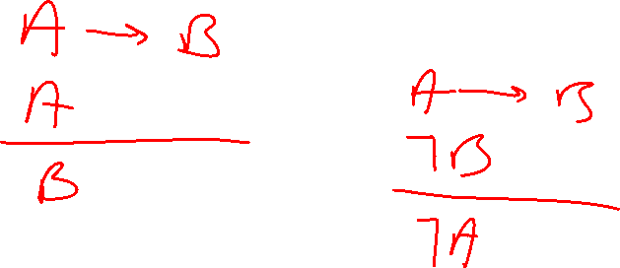
Inference rules - Modus Ponens
Definition:
$$\frac{p_{1},…,p_{k}, \left(p_{1}∧…∧p_{k}\right)→q}{q}$$

Slide 136
Inference rules – Forward Inference
Input: set of inference rules Rules
Repeat until no changes to KB
Choose set of formulas $f_{1},…, f_{k}∈KB$
If matching rule $\frac{f_{1}, … ,f_{k}}{g}$ exists:
Add g to KB
Derivation: KB derives/proves $f (KB ⊢ f)$if f eventually gets added to KB.

Slide 137
Modus Ponens forward inference example
Starting with
$$KB=\left\{Rain, Rain→Wet, Wet→Slippery \right\}$$
Apply modus ponens to $Rain$ and $Rain→Wet$:
$$KB=\left\{Rain, Rain→Wet, Wet→Slippery, Wet\right\}$$
Apply modus ponens to $Wet$ and $Wet → Slippery$:
$$KB=\left\{Rain, Rain→Wet, Wet→Slippery, Wet,Slippery\right\}$$
Converged
See that: we can’t derive formulas: $¬Wet, Rain→Slippery$

Slide 138
Identities on literals and Horn clauses
Literal: $p, ¬p$
Written w. implication Written w. disjunction
$p→q$ $¬p∨q$ (1)
$A∧B→C$ $¬A∨¬B∨C$ (2) from (1) and (3)
$¬\left(p∧q\right)$ $¬p∨¬q$ (3)
$¬\left(p∨q\right)$ $¬p∧¬q$ (4)
Clause = disjunctions (or) of literals
Horn Clause = at most one positive literals

Slide 139
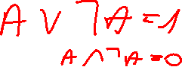
Resolution
General clauses have any number of literals
Example:
$$\frac{Rain∨Snow, ¬Snow∨Traffic}{Rain∨Traffic}$$
Def.:
$$\frac{f_{1}∨ …∨f_{n}∨p, ¬p∨g_{1}∨…∨g_{m}}{f_{1}∨ …∨f_{n}∨g_{1}∨…∨g_{m}}$$

Slide 140
Conjunctive normal form (CNF)
Formulas can come in any shape
Conjunction of clauses: $\left(A∨B∨¬C\right)∧\left(¬B∨D\right)$
Any formula in propositional logic can be converted into CNF.

Slide 141

Resolution algorithm
„proof by contradiction”
$$KB \text{⊧} \text{f} \text{is} \text{the} \text{same} \text{then} \text{KB} ∪\left\{¬f\right\} is unsatisfiable$$
Algorithm:
Add $¬f$ to KB
Convert all formulas into CNF
Repeatedly apply resolution rule
Return entailment if derive false

Slide 142
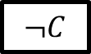
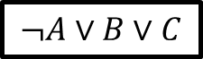
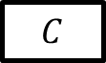

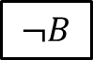
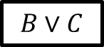
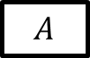
Example
$KB=\left\{A→\left(B∨C\right),A,¬B\right\}, f=C$
Adding $¬f$: $KB^{′}=\left\{A→\left(B∨C\right),A,¬B, ¬C\right\}$
Convert to CNF: $KB^{′}=\left\{¬A∨B∨C,A,¬B, ¬C\right\}$
Repeatedly apply resolution rule:
Empty clause
$$C$$
$$¬C$$
$$B∨C$$
$$¬B$$
Conclusion: KB entails f
$$¬A∨B∨C$$
$$A$$

Slide 143
Motivation of First Order Logic is the limitations from Propositional Logic
Alice and Bob both knows arithmetic
$AliceKnowsArithmetic∧BobKnowsArithmetic$
All student knows arithmetic
????
$AliceIsStudent→AliceKnowsArithmetic$
$BobIsStudent→BobKnowsArithmetic$
….
Every even integer is greater than 2 is the sum of two primes.
???

Slide 144
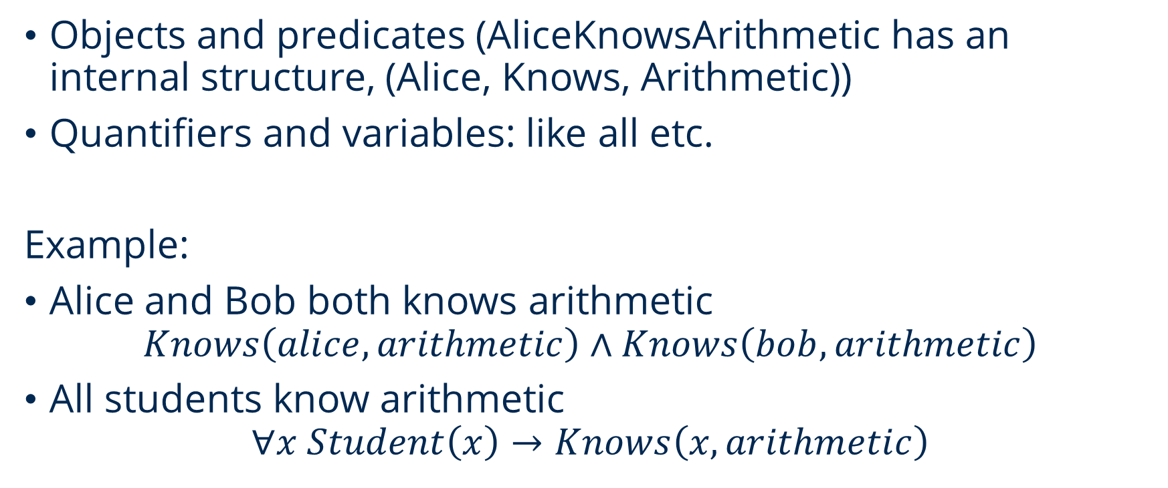

What is missing?
Objects and predicates (AliceKnowsArithmetic has an internal structure, (Alice, Knows, Arithmetic))
Quantifiers and variables: like all etc.
Example:
Alice and Bob both knows arithmetic
$$Knows\left(alice, arithmetic\right)∧Knows\left(bob, arithmetic\right)$$
All students know arithmetic
$$∀x Student\left(x\right)→Knows\left(x, arithmetic\right)$$

Slide 145
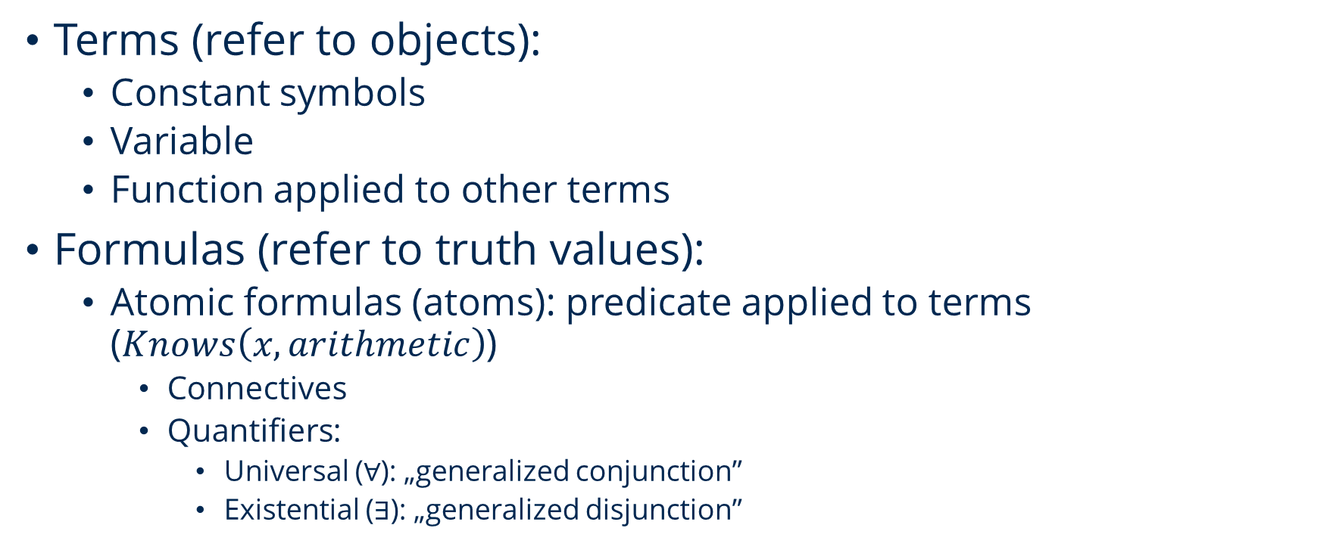
Syntax
Terms (refer to objects):
Constant symbols
Variable
Function applied to other terms
Formulas (refer to truth values):
Atomic formulas (atoms): predicate applied to terms ($Knows\left(x, arithmetic\right)$)
Connectives
Quantifiers:
Universal ($∀$): „generalized conjunction”
Existential ($∃$): „generalized disjunction”

Slide 146

Properties of quantifiers
$$¬∀x P\left(x\right) is equivalent to ∃x ¬P\left(x\right)$$
$$∀x∃y Knows\left(x,y\right) different ∃y∀x Knows\left(x,y\right)$$
In natural language:
Every student knows arithmetic.
$$∀x Student\left(x\right)→Know\left(x, arithmetic\right)$$
Some student knows arithmetic.
$$∃x Student\left(x\right)∧Knows\left(x,arithmetic\right)$$

Slide 147

Some examples
There is some course that every student has taken
$$∃y Course\left(y\right)∧\left[∀x Student\left(x\right)→Takes\left(x,y\right)\right]$$
Every even integer greater than 2 is the sum of two primes
$$∀x EvenInt\left(x\right)∧Greater\left(x,2\right)→∃y∃z Equals\left(x, Sum\left(z,y\right)\right)∧Prime\left(y\right)∧Prime\left(z\right)$$
If a student takes a course and the course covers a concept, then the student knows that concept.
$$∀x∀y∀z\left(Student\left(x\right)∧Takes\left(x,y\right)∧Course\left(y\right)∧Covers\left(y,z\right)\right)→Knows\left(x,z\right)$$

Slide 148
Models
Constant symbols to objects
$w\left(alice\right)=o_{1} , w\left(bob\right)=o_{2} , w\left(arithmetic\right)=o_{3}$
Predicate symbols to tuples of objects
$w\left(Knows\right)=\left\{\left(o_{1},o_{3}\right),\left(o_{2},o_{3}\right),…\right\}$
1 constant symbol = 1 object

Slide 149

Resolution for first-order logic Examples
A1: There is a patient who trusts every doctor.
A2: No patient trusts a fraudster.
Let's see
B: No doctor is a fraudster.
Formalization:
$P(x):$ x is patient
$D(y):$ y is doctor
$K(y):$ y is fraudster
$M(x,y):$ x trusts y

Slide 150

Resolution for first-order logic Example (cont.)
Formalization:
$P(x):$ x is patient $A1: ∃x\{P(x) ∧ ∀y[D(y) → M(x,y)]\}$
$D(y):$ y is doctor $A2: ∀x\{P(x) → ∀y[K(y) → ¬M(x,y)]\}$
$K(y):$ y is fraudster $B: ∀x[D(x) → ¬K(x)]$
$M(x,y):$ x trusts y
Need: $$∃x\{P(x) ∧ ∀y[D(y) → M(x,y)]\} ∧ ∀x\{P(x) → ∀y[K(y) →¬M(x,y)]\} ∧¬ ∀x[D(x) → ¬K(x)]$$
is unsatisfiable

Slide 151

Resolution for first-order logic Skolem conjuctive normal form
1. We eliminate the operation signs $↔$ and $→$
2. We reduce the scope of negations (DeMorgan identities)
3. We standardize the variables (renaming by quantifiers)
4. Elimination of existential quantifiers. (Skolemization:
$∀x1 … ∀xn∃zF(…, z, …) to ∀x1… ∀xn F(…, f(x1, … , xn), …)$
– not an equivalent transformation, but satisfiability holds)
5. Highlighting universal quantifiers at the beginning of the formula (prenex normal form)
6. The rest of the formula is converted to conjunctive normal form (commutative, associative, distributive laws).
7. We create the clauses (the quantifiers and the conjunction operation signs are omitted, the variables are renamed individually for each clause.)

Slide 152

Resolution for first-order logic Skolem conjuctive normal form
A1: $∃x\left\{P\left(x\right)∧ ∀y\left[D\left(y\right)→M\left(x,y\right)\right]\right\} = …$ $$= P(a), ¬D(y)∨M(a,y)$$
A2: $∀x\left\{ P\left(x\right)→ ∀y\left[K\left(y\right)→ ¬M\left(x,y\right)\right]\right\}= …$ $$= ¬P(x) ∨ ¬K(u) ∨ ¬M(x,u)$$
B: $¬∀x[ D(x) → ¬K(x)] = …$ $$= D(b) , K(b)$$

Slide 153
Resolution for first-order logic Procedure
∀y
∀x∀u
P(a) ¬D(y) ∨ M(a,y) ¬P(x)∨¬K(u)∨¬M(x,u) D(b) K(b)
{y|b}
M(a,b)

Slide 154
Resolution for first-order logic Procedure
∀y
∀x∀u
P(a) ¬D(y) ∨ M(a,y) ¬P(x)∨¬K(u)∨¬M(x,u) D(b) K(b)
{x|a}
{y|b}
∀v
¬K(v)∨¬M(x,v)
M(a,b)

Slide 155
Resolution for first-order logic Procedure
∀y
∀x∀u
P(a) ¬D(y) ∨ M(a,y) ¬P(x)∨¬K(u)∨¬M(x,u) D(b) K(b)
{x|a}
{y|b}
∀v
¬K(v)∨¬M(a,v)
M(a,b)
{v|b}
¬K(b)

Slide 156
Resolution for first-order logic Procedure
P(a) ¬D(y) ∨ M(a,y) ¬P(x)∨¬K(u)∨¬M(x,u) D(b) K(b)
{x|a}
{y|b}
¬K(v)∨¬M(x,v)
M(a,b)
{v|b}
¬K(b)
□

Slide 157
Resolution for first-order logic Answer extraction
"If Fifi follows John everywhere, and
John is now at school,
then where is Fifi now?„
Formalization:
H(y,x) ~ thing y is at location x
∀x[H(John,x) → H(Fifi,x)]
H(John, school)
First, let's see if there is a place for Fifi in the world?
∃xH(Fifi,x)

Slide 158
Resolution for first-order logic Answer extraction
Refutation graph
¬H(Fifi,x2) ¬H(John, x1) ∨ H(Fifi,x1)
¬H(John, v)
H(John, school)
□

Slide 159
Resolution for first-order logic Answer extraction
Refutation graph
¬H(Fifi,x2) ¬H(John, x1) ∨ H(Fifi,x1)
¬H(John, v)
H(John, school)
□
Answer extraction graph
¬H(Fifi,x2) ¬H(John, x1) ∨ H(Fifi,x1)
H(Fifi, x2) ∨
H(Fifi, v) ∨
¬H(John, v)
H(John, school)
{v|school}
H(Fifi, school)

Slide 160

Resolution for first-order logic Resolution strategies
The resolution is non-deterministic. In one step
there can be several resolvable pairs of clauses at the same time
a pair of clauses can have several complementary literal pairs
the same literal can have multiple occurrences
$\{P(x,f(a))∨P(x,f(y))∨Q(y), ¬P(z,f(a))∨¬Q(z), P(u,f(a )) ∨ ¬Q(a)\}$
A resolution strategy is a specification that supplements the basic resolution algorithm
assigns a sequence to the resolvent production (sequential strategy)
limits the range of resolvents that can be produced at a given moment (cutting strategy)

Slide 161
Rule-based reasoning
In the case of a problem A1, …, An ⇒ C, the axioms are classified into two groups: rules and facts.
axioms facts specific knowledge
without implication
rules general knowledge
with implication

Slide 162
Rule-based reasoning Forward and backward chaining
Forward chaining: using a suitable (matchable) rule derives a new statement from a statement.
fact: Dog(Fifi) ∧ Postman(Paul)
rule: ∀x∀y Dog(x) ∧ Postman(y) → Bite(x,y)
proof: Bite(Fifi, Paul)
Backward chaining: the proof of a statement leads back to the proof of the precondition of a suitable (matchable) rule target:
goal: Dog(Fifi)
rule: ∀x Bark(x) → Dog(x)
it is enough to proof: Bark(Fifi)

Slide 163
Rule-based reasoning Directions of rule-based inference
A problem defined by facts, rules and a goal statement can be proven
moving forward: starting from the facts and chaining forward, we derive new statements, then even newer ones from them, until we get the target statement
moving backwards: the goal is replaced by sub-goals by chaining backwards, the sub-goals are replaced by further sub-goals until we reach sub-goals that can be justified by facts.

Slide 164
Rule-based reasoning Forward rule-based representation
Fact:
Universally bound, arbitrary AND/OR expression
Rules:
Universally bound expressions of the form L → W, where L is a literal and W is an AND/OR expression
Goal:
L1 ∨ … ∨ Ln is an existential bound expression, where L1, … , Ln are literals

Slide 165
Rule-based reasoning Backward rule-based representation
Fact:
L1 ∧ … ∧ Ln universal bound expression, where L1,… ,Ln are literals.
Rules:
Universally bound expressions of the form W → L, where L is a literal and W is an AND/OR expression
Goal:
existentially bound arbitrary AND/OR expression

Slide 166
Rule-based reasoning Backward rule-based representation (example)
Fifi and Killer are dogs, Fifi wags her tail, Cili meows. Animals that meow are cats. A dog that wags its tail is friendly. Cats are not afraid of friendly dogs.
Name a dog-cat match where the cat is not afraid of the dog!
Formalization:
D(x) ~ x is dog
C(x) ~ x is cat
W(x) ~ x wags
M(x) ~ x meows
F(x) ~ x is friendly
S(x,y) ~ x scared of y
Fact: D(Fifi) ∧ D(Killer) ∧ W(Fifi) ∧ M(Cili)
Rules:
∀x (M(x) → C(x))
∀x (D(x) ∧ W(x) → F(x))
∀x∀y (D(x) ∧ F(x) ∧ C(y) → ¬S(y,x))
Goal: ∃x∃y (C(x) ∧ ¬ S(x,y) ∧ D(y))

Slide 167
Rule-based reasoning Backward rule-based representation (proof)
Fact: D(Fifi) ∧ D(Killer) ∧ W(Fifi) ∧ M(Cili)
Rules:
(1) ∀x (M(x) → C(x))
(2) ∀x (D(x) ∧ W(x) → F(x))
(3) ∀x∀y (D(x) ∧ F(x) ∧ C(y) → ¬S(y,x))
Goal: ∃x∃y (C(x) ∧ ¬ S(x,y) ∧ D(y))
C(x) ∧ ¬ S(x,y) ∧ D(y)

Slide 168
Rule-based reasoning Backward rule-based representation (proof)
Fact: D(Fifi) ∧ D(Killer) ∧ W(Fifi) ∧ M(Cili)
Rules:
(1) ∀x (M(x) → C(x))
(2) ∀x (D(x) ∧ W(x) → F(x))
(3) ∀x∀y (D(x) ∧ F(x) ∧ C(y) → ¬S(y,x))
Goal: ∃x∃y (C(x) ∧ ¬ S(x,y) ∧ D(y))
C(x) ∧ ¬ S(x,y) ∧ D(y)
C(x)
¬ S(x,y)
D(y)

Slide 169
Rule-based reasoning Backward rule-based representation (proof)
Fact: D(Fifi) ∧ D(Killer) ∧ W(Fifi) ∧ M(Cili)
Rules:
(1) ∀x (M(x) → C(x))
(2) ∀x (D(x) ∧ W(x) → F(x))
(3) ∀x∀y (D(x) ∧ F(x) ∧ C(y) → ¬S(y,x))
Goal: ∃x∃y (C(x) ∧ ¬ S(x,y) ∧ D(y))
C(x) ∧ ¬ S(x,y) ∧ D(y)
C(x)
¬ S(x,y)
D(y)
M(x)
M(Cili)
{x|Cili}

Slide 170
Rule-based reasoning Backward rule-based representation (proof)
Fact: D(Fifi) ∧ D(Killer) ∧ W(Fifi) ∧ M(Cili)
Rules:
(1) ∀x (M(x) → C(x))
(2) ∀x (D(x) ∧ W(x) → F(x))
(3) ∀x∀y (D(x) ∧ F(x) ∧ C(y) → ¬S(y,x))
Goal: ∃x∃y (C(x) ∧ ¬ S(x,y) ∧ D(y))
C(x) ∧ ¬ S(x,y) ∧ D(y)
C(x)
¬ S(x,y)
D(y)
M(x)
D(y)
F(y)
C(x)
M(Cili)
D(Fifi)
D(Killer)
{x|Cili}
{y|Fifi}

Slide 171
Rule-based reasoning Backward rule-based representation (proof)
Fact: D(Fifi) ∧ D(Killer) ∧ W(Fifi) ∧ M(Cili)
Rules:
(1) ∀x (M(x) → C(x))
(2) ∀x (D(x) ∧ W(x) → F(x))
(3) ∀x∀y (D(x) ∧ F(x) ∧ C(y) → ¬S(y,x))
Goal: ∃x∃y (C(x) ∧ ¬ S(x,y) ∧ D(y))
C(x) ∧ ¬ S(x,y) ∧ D(y)
C(x)
¬ S(x,y)
D(y)
M(x)
D(y)
F(y)
C(x)
M(Cili)
D(Fifi)
D(Killer)
D(y)
W(y)
{x|Cili}
{y|Fifi}
D(Fifi)
D(Killer)
W(Fifi)
{y|Fifi}
{y|Fifi}

Slide 172
Rule-based reasoning Backward rule-based representation (proof)
Fact: D(Fifi) ∧ D(Killer) ∧ W(Fifi) ∧ M(Cili)
Rules:
(1) ∀x (M(x) → C(x))
(2) ∀x (D(x) ∧ W(x) → F(x))
(3) ∀x∀y (D(x) ∧ F(x) ∧ C(y) → ¬S(y,x))
Goal: ∃x∃y (C(x) ∧ ¬ S(x,y) ∧ D(y))
C(x) ∧ ¬ S(x,y) ∧ D(y)
C(x)
¬ S(x,y)
D(y)
M(x)
D(y)
F(y)
C(x)
M(Cili)
D(Fifi)
D(Killer)
D(y)
W(y)
M(x)
{x|Cili}
{y|Fifi}
D(Fifi)
D(Killer)
M(Cili)
W(Fifi)
{y|Fifi}
{x|Cili}
{y|Fifi}

Slide 173
Rule-based reasoning Backward rule-based representation (proof)
Fact: D(Fifi) ∧ D(Killer) ∧ W(Fifi) ∧ M(Cili)
Rules:
(1) ∀x (M(x) → C(x))
(2) ∀x (D(x) ∧ W(x) → F(x))
(3) ∀x∀y (D(x) ∧ F(x) ∧ C(y) → ¬S(y,x))
Goal: ∃x∃y (C(x) ∧ ¬ S(x,y) ∧ D(y))
C(x) ∧ ¬ S(x,y) ∧ D(y)
C(x)
¬ S(x,y)
D(y)
M(x)
D(y)
F(y)
C(x)
D(Fifi)
D(Killer)
{y|Fifi}
M(Cili)
D(Fifi)
D(Killer)
D(y)
W(y)
M(x)
{x|Cili}
{y|Fifi}
D(Fifi)
D(Killer)
M(Cili)
W(Fifi)
{y|Fifi}
{x|Cili}
{y|Fifi}

Slide 174
Rule-based reasoning Backward rule-based representation (proof)
Fact: D(Fifi) ∧ D(Killer) ∧ W(Fifi) ∧ M(Cili)
Rules:
(1) ∀x (M(x) → C(x))
(2) ∀x (D(x) ∧ W(x) → F(x))
(3) ∀x∀y (D(x) ∧ F(x) ∧ C(y) → ¬S(y,x))
Goal: ∃x∃y (C(x) ∧ ¬ S(x,y) ∧ D(y))
C(x) ∧ ¬ S(x,y) ∧ D(y)
C(x)
¬ S(x,y)
D(y)
M(x)
D(y)
F(y)
C(x)
D(Fifi)
D(Killer)
{y|Fifi}
M(Cili)
D(Fifi)
D(Killer)
D(y)
W(y)
M(x)
{x|Cili}
{y|Fifi}
D(Fifi)
D(Killer)
M(Cili)
W(Fifi)
{y|Fifi}
{x|Cili}
{x|Cili}
{y|Fifi}
{y|Fifi}

